Slide 1


Slide 2

Agenda
Review Linux file structure
FTK imager
Lab
https://cyberdefenders.org/
FTK manager

Slide 3
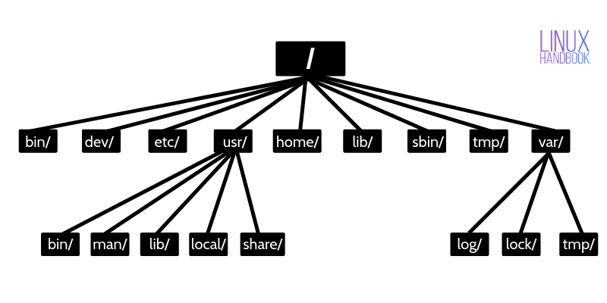

Slide 4
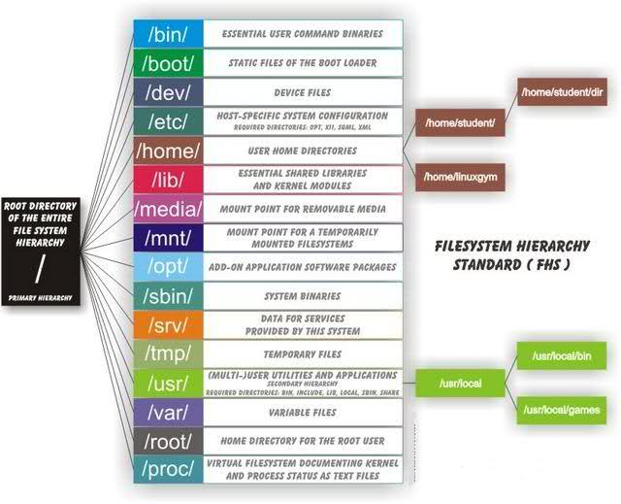

Slide 5
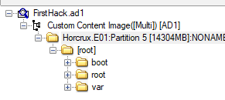

Slide 6
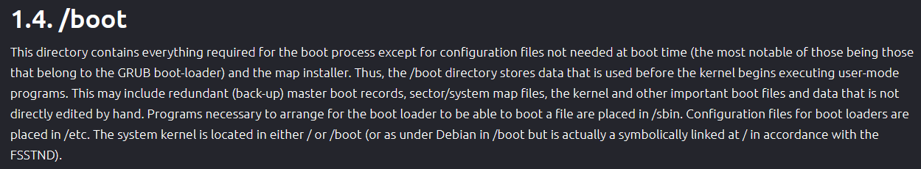
https://www.coding-bootcamps.com/linux/filesystem/boot.html

Slide 7
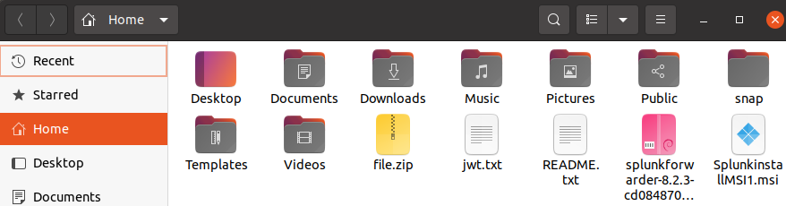
/Home

Slide 8
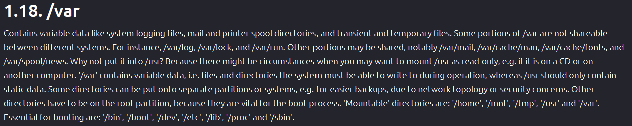
https://www.coding-bootcamps.com/linux/filesystem/var.html

Slide 9
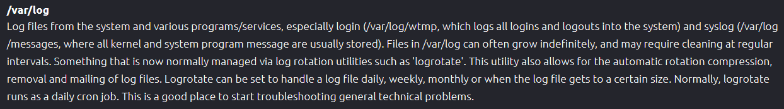
https://www.coding-bootcamps.com/linux/filesystem/var.html

Slide 10
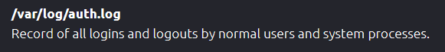
https://www.coding-bootcamps.com/linux/filesystem/var.html

Slide 11
Bash (terminal/CLI) History
/home/user/.bash_history
/root/.bash_history

Slide 12
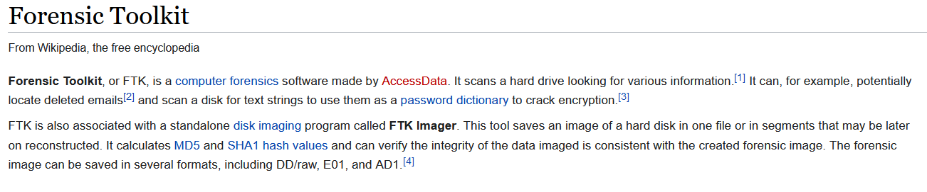
What is FTK?
https://sites.google.com/site/itec6322spring2010/home/outside-readings/autopsy-vs-ftk-imager-manson

Slide 13
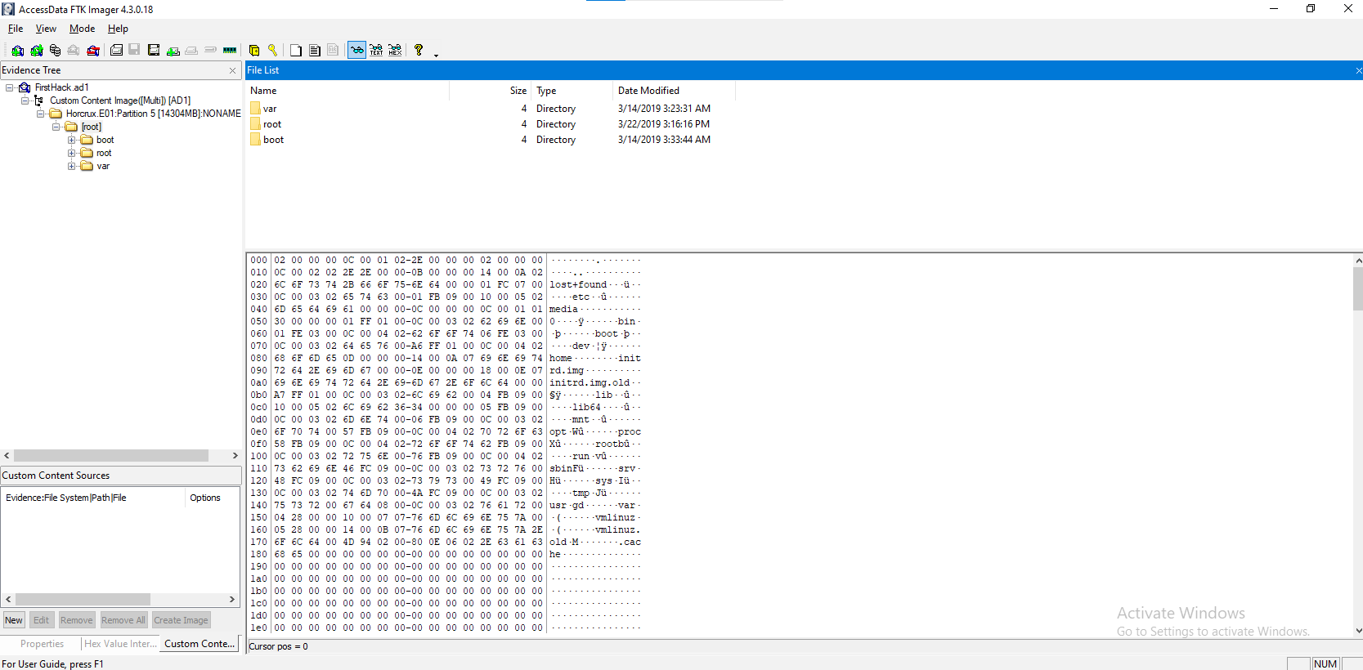

Slide 14
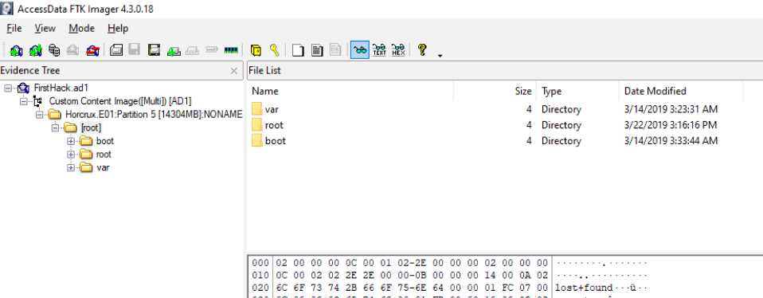

Slide 15
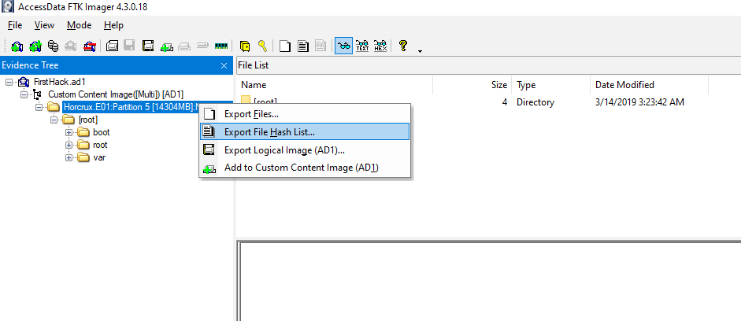

Slide 16

Lab @ https://cyberdefenders.org/
FTK imager
Create free account @ https://cyberdefenders.org/
Under ‘Practice’ tab, Search ‘Insider’
https://cyberdefenders.org/blueteam-ctf-challenges/64

Slide 17
Question 1
What distribution of Linux is being used on this machine?

Slide 18
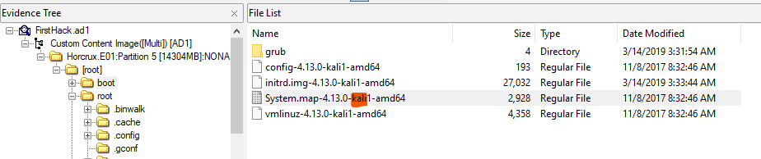

Slide 19
Question 2
What is the MD5 hash of the apache access.log?

Slide 20
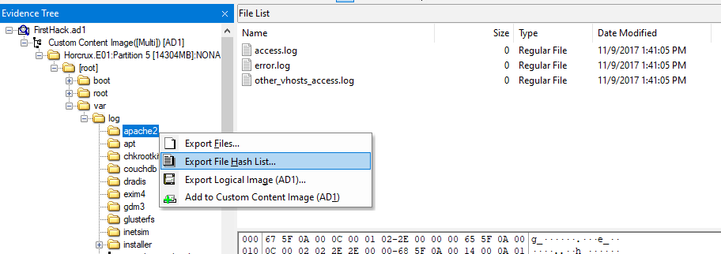
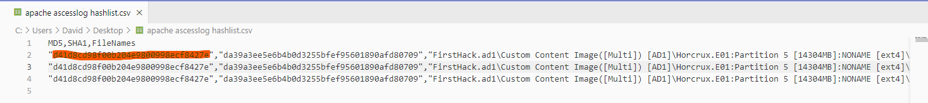

Slide 21
Q 3
It is believed that a credential dumping tool was downloaded? What is the file name of the download?

Slide 22
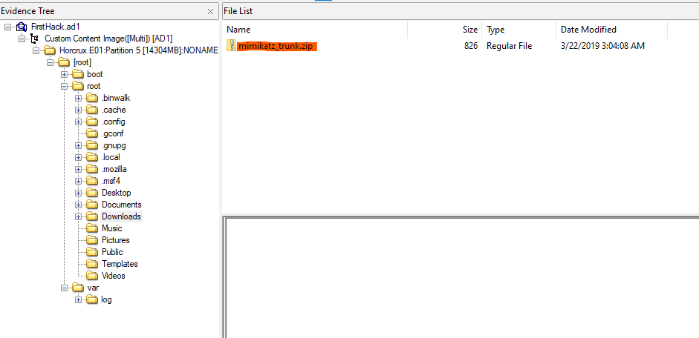

Slide 23
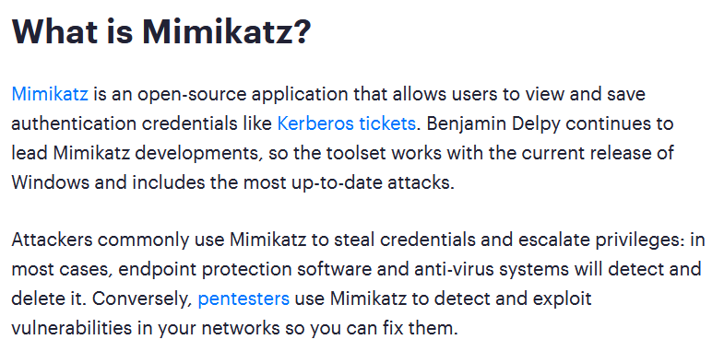

Slide 24
Pass the Hash
Pass the Ticket
Over the Pass hash
Kerberos golden ticket
Kerberos siler ticket
Pass the Cache
https://www.varonis.com/blog/what-is-mimikatz

Slide 25
Q 4
There was a super-secret file created. What is the absolute path?

Slide 26
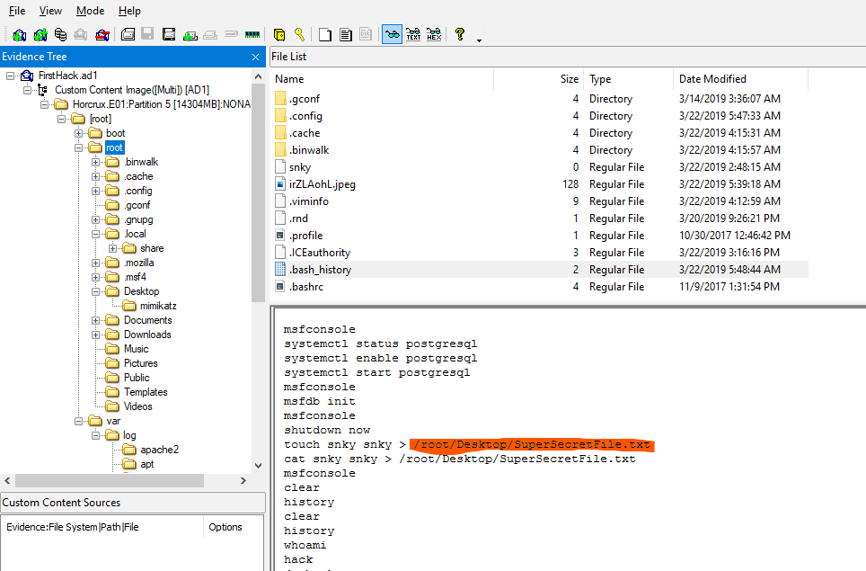

Slide 27
Q 5
What program used didyouthinkwedmakeiteasy.jpg during execution?

Slide 28
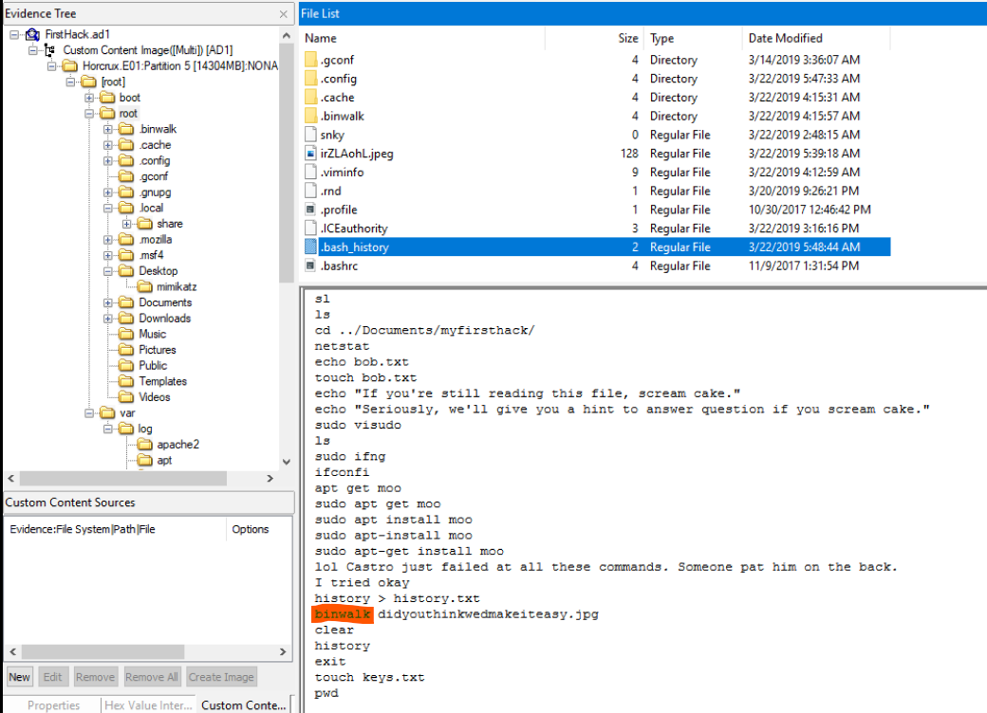

Slide 29
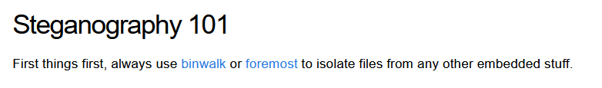
https://www.kali.org/tools/binwalk/
https://pequalsnp-team.github.io/cheatsheet/steganography-101

Slide 30
Q 6
What is the third goal from the checklist Karen created?

Slide 31
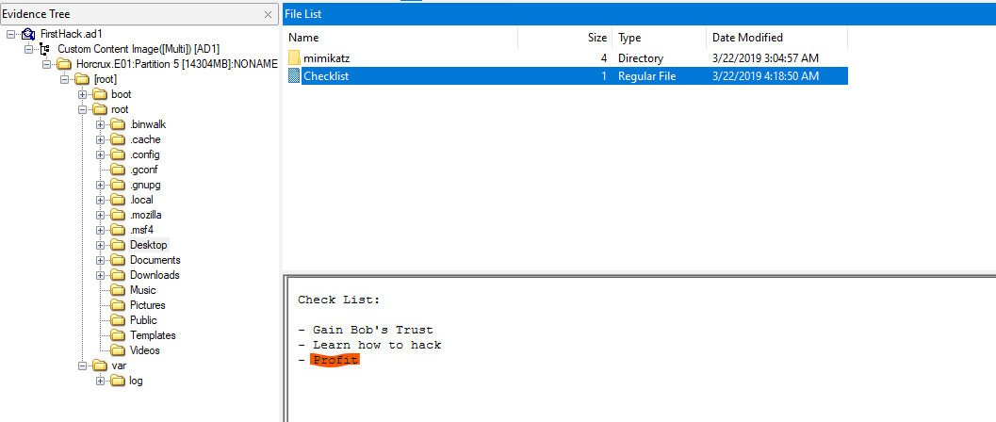

Slide 32
Q 7
How many times was apache run?

Slide 33
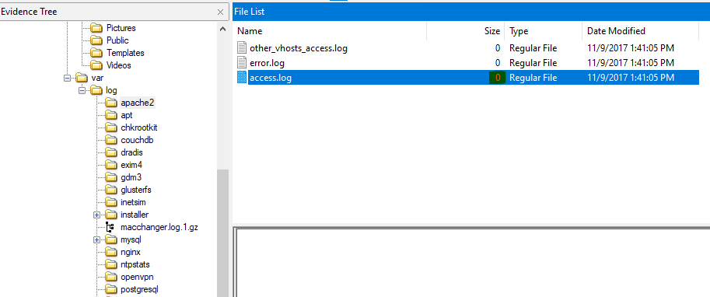

Slide 34
Q 8
It is believed this machine was used to attack another. What file proves this?

Slide 35
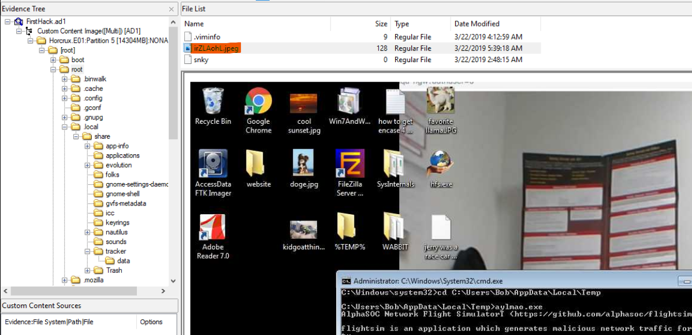

Slide 36
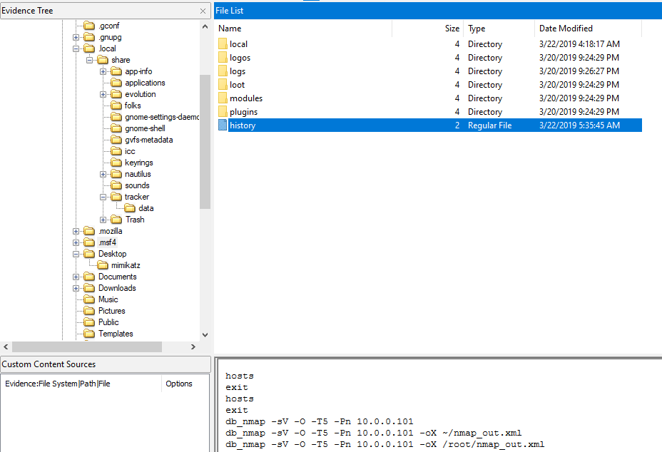

Slide 37
Q 9
Within the Documents file path, it is believed that Karen was taunting a fellow computer expert through a bash script. Who was Karen taunting?

Slide 38
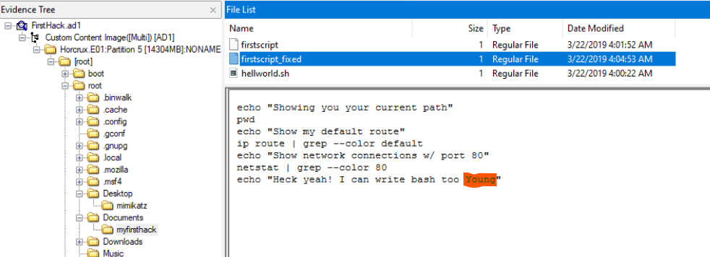

Slide 39
Q 10
A user su'd to root at 11:26 multiple times. Who was it?

Slide 40
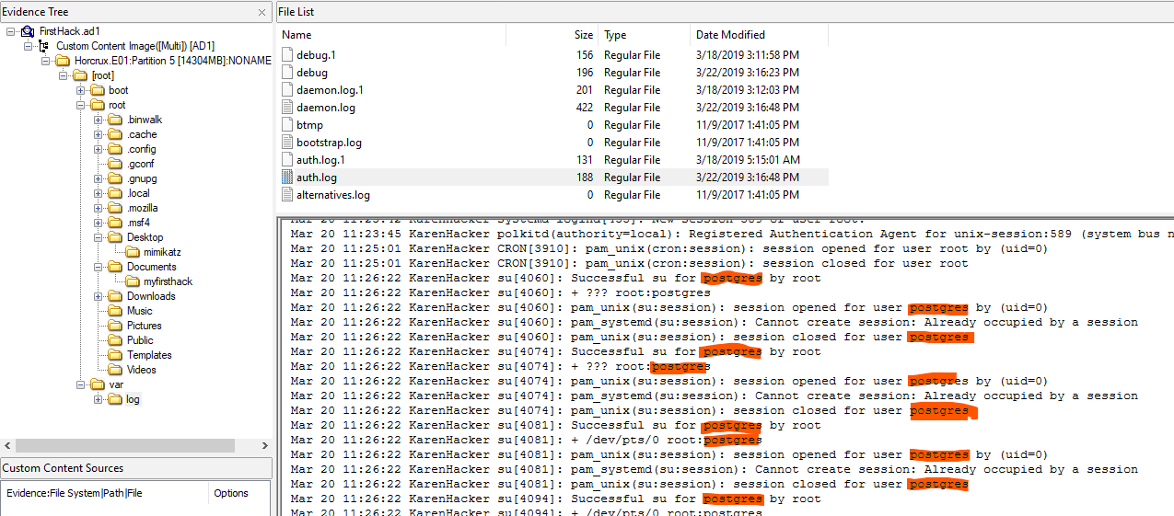

Slide 41
Q 11
Based on the bash history, what is the current working directory?

Slide 42
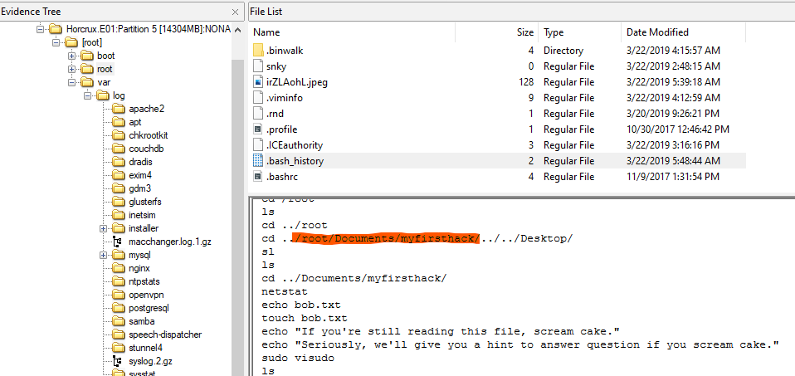

Slide 43

Questions?

